Slide 1

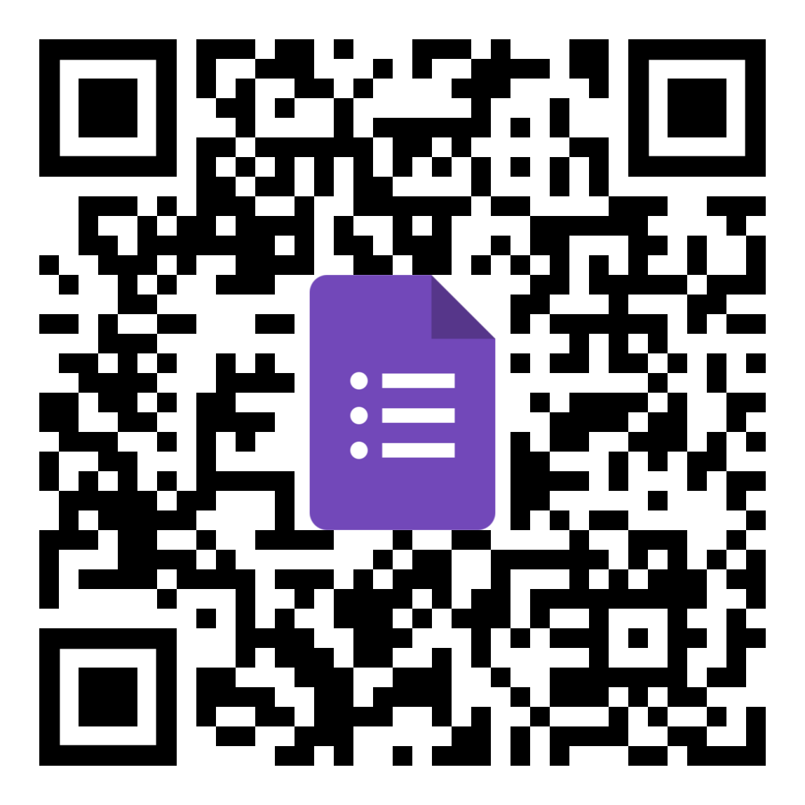

Machine Learning Approaches with National Student Clearinghouse
Steven Sherrin, Wentworth Institute of Technology
Statistics, Methods, & Code
Do You Want To Collaborate?
Connect With Me

